Slide 1
Entrepreneurship
Lecture 2: The Entrepreneurial Mindset
Notes:
The entrepreneurial mindset is the foundation of all entrepreneurship!
This is especially relevant to Ghana. Many sources say that among African countries, Ghanaians are some of the most entrepreneurial. They have several character traits that help them out: they are inventive, most likely to see opportunities in a bad situation, willing to take charge, etc. Many foreigners are looking to Ghana to be one of Africa’s future economic leaders.
Today we’ll talk more about what constitutes the ideal entrepreneurial mindset, so you know what’s ahead of you. Hopefully, knowing the attitude you have to portray will help you succeed.

Slide 2
Lecture Outline
Entrepreneurship defined
The traits of an entrepreneur…
  Based on Jeff Bezos, the founder of the online bookstore, Amazon.com
Brief profiles of entrepreneurs
Group assignment
Personal assignment

Slide 3
What is entrepreneurship?
The process of creating a business enterprise capable of:
Entering new or established markets by deploying resources and people in a unique way

Slide 4
Who is an entrepreneur?
A person who creates and manages change by the recognition of opportunities (needs, wants, problems, and challenges)
and manages resources
…in order to take advantage of the opportunity and create a venture.

Slide 5
The entrepreneurial mindset
An entrepreneur views needs, problems and challenges as opportunities.
An entrepreneur comes up with innovative ways to deal with challenges/problems.
An entrepreneur realizes that he/she is in the business of creating value.
An entrepreneur thinks/learns ahead and consolidates opportunities before they become obvious.
An entrepreneur is a visionary and a leader

Slide 6
Sees needs as opportunities
An entrepreneur sees the problems/needs around her and sees opportunities to make profits or create value.
Needs and problems are a blessing to the entrepreneur!
Example
  Your thirst is Coca-Cola’s opportunity to sell you Coke

Slide 7

Coca-Cola Advertisement

Slide 8
Innovative ways to solve problems
An entrepreneur is a skilled problem solver and uses the resources around him to solve problems.
Example
  Jeff Bezos, the founder of Amazon.com solved a problem for people who have used books but don’t know what to do with them. He created a website that allowed such people to meet online and sell used books to each other and in the process created a billion dollar company.

Slide 9
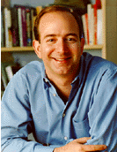
Jeff Bezos, Founder of Amazon.com

Slide 10
Entrepreneurs create value
Entrepreneurs create value to society by:
Increasing the number of customers served by a product/service
Reducing the costs of a business
Improving on the quality of products and services
Inventing a new product or service!

Slide 11
How Amazon.com creates value
Because it can be accessed online, anyone with internet access can use it
After initial success with book swapping it began providing more services to members by selling new books, movies, electronics, etc.
It has continually improved its website to make it as customer friendly as possible
Notes:
Interesting website! They are very entrepreneurial by using unique methods to be more appealing to consumers:
Slight website changes (layout)
They keep adding new features to stay ahead of the competition. E.g. book reviews, new items like CDs and toys, clothes
Very convenient search features like “most popular”, “by genre”, title and topic searches, etc.

Slide 12
Amazon.com vs. a Bookstore
Amazon.com is online and open 24/7.
Anyone who has access to the internet and a credit card is a potential customer.
Amazon has automated customer handling processes – needs less employees and therefore has lower costs
Amazon has millions of book titles and you can find any book you’d want from them

Slide 13
A forward thinker
Before opportunities become obvious, an entrepreneur quickly moves in and consolidates his position:
In 1994, Jeff Bezos read that the web was growing at a rate of 2,300% a year.
He quit his job on Wall Street and started looking for a way he could benefit from the phenomenal growth
Decided to sell books online since he noted that there were 3 million books in print in the world and there was a need to be able to organize them, search them and sell them electronically.
He realized that it was only a matter of time before the internet spread world wide and knew he had to take a chance immediately

Slide 14
A Can-Do attitude
An entrepreneur is a visionary, an optimist, a strategist, confident and very hard working.
He/She is willing to go where others have not been and will not give up on his/her dream when others say it can’t be done.
If an entrepreneur can’t win the game he will change the rules of the game to come up with a new solution to a problem!
He/She is challenged by the words- “It can’t be done.”
Notes:
Change the rules of the game to come up with a new solution to a problem! E.g.
e.g. people don’t want to buy your books because you are far away, you can get these people to seek you out faster by providing them with a website and sending them the books.

Slide 15
A visionary and a leader
Entrepreneurs lead and others follow.
In the process they generate value for themselves and others.
Amazon.com has created value for the millions of customers since it makes it easy for them to find books they need from the comfort of their home
It has also helped authors sell their books
In the process, Jeff becomes $4.8 Billion richer. This is equivalent to 365 Billion Ksh!

Slide 16
Entrepreneurs as leaders (TIE)
Entrepreneurship is the ONLY source of new wealth and new productive jobs in society.
It only takes a small part of the population, 1-2%, to become successful entrepreneurs in order to pull the whole society along.
Throughout history, countries that have nurtured entrepreneurial culture have been the most successful and dynamic.
Entrepreneurs are at the heart of success of modern economies.
Society must encourage and reward entrepreneurial activities
Source: TIE: The Indus Entrepreneurs

Slide 17
Entrepreneurs are risk takers
Successful entrepreneurs are not afraid of failure.
They acknowledge failure but prepare for it.
However, if they fail they can quickly learn from their mistakes and try again!
Jeff Bezos quit his well-paying job in order to found Amazon.com without any guarantees of success.

Slide 18
Entrepreneurs as visionaries
Jeff Bezos reads about the huge growth rate of the web.
He makes a list of 20 commodities that he could sell on the net
Settles on books since there is a large market that can be made easier to access and can be greatly improved upon
As the business grows, he expands the market by selling CDs and DVDs
Eventually he adds toys, clothes etc.
Amazon now has 39 million customers

Slide 19
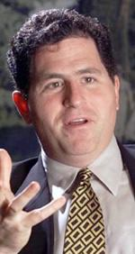
Michael Dell - Computers
  Founded the largest PC maker in the world out of his college dormitory.
  Built a personal wealth of more than $20 Billion US and inspired millions of entrepreneurs.
  At age 15, he tore up a computer and put it back together
  Started selling computer parts to his friends and then grew the business

Slide 20
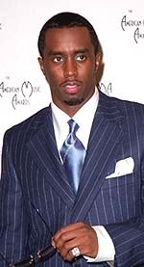
P. Diddy – Entertainment etc.
After a successful music career ventured into many businesses using his celebrity status as a resource
Interests:
  Sean-John Clothing Company
  Bad Boy Productions
  Restaurants
  Studios
Very creative and versatile entrepreneur who has managed to create a huge net worth and is active in his community

Slide 21

Kase Lawal – Oil industry
Nigerian-American entrepreneur in the Oil and Gas exploration industry
Camac Holdings has revenues of more than $1billion per year

Slide 22
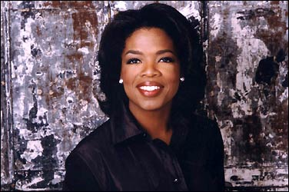
Oprah Winfrey – Harpo Productions
Talk-Show host of the Oprah Winfrey show
O-Magazine
Oxygen Media
Personal value of more than $1billion dollars
She’s turned the business of counseling into major business

Slide 23
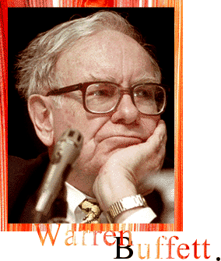
Warren Buffett - Investor
Warren Buffett is the World’s Greatest Investor
He is Chairman and CEO of Berkshire Hathaway, an investment company which buys businesses and then increases their value
Buffett is the second richest man in the world with a net worth of over $40billion US,
He has built his empire slowly but steadily using time-tested investment principles

Slide 24
Group Assignment
Identify a successful entrepreneur.
How did the entrepreneur create value?
How did the entrepreneur use the resources around her/him to satisfy needs or solve problems?
Present to the class!

Slide 25
Personal Assignment
Write a one page article about something you dislike in your everyday life and find, as an entrepreneur, an innovative way to fix it
Process:
  Find a need
  Identify an opportunity
  Take advantage of resources

